Slide 1

Supervised Learning
André Sousa (up202005277@fe.up.pt)
Gonçalo Pinto (up202004907@fe.up.pt)
Pedro Fonseca (up202008307@fe.up.pt)
AI Second Project

Slide 2
Software used and related work
Stuart Russell, Peter Norvig; Artificial intelligence. ISBN: 978-0-13-207148-2
Richard S. Sutton; Reinforcement learning. ISBN: 978-0-262-03924-6
Stuart Russel, Peter Norvig; Artificial Intelligence: A modern Approach.
Exercise5 IART SupervisedLearning

Slide 3
Specification of the work
Goal: Analyze and study the process of classification (data preprocessing, feature selection, model selection, model training and model evaluation)
Project Objectives:
Given a data set, predict the target feature
Compare multiple algorithms and feature selection to achieve the best results
Algorithms: Decision Tree, Neural Network (MLP), k-nearest neighbors (KNN) and Support Vector Machine (SVM)

Slide 4
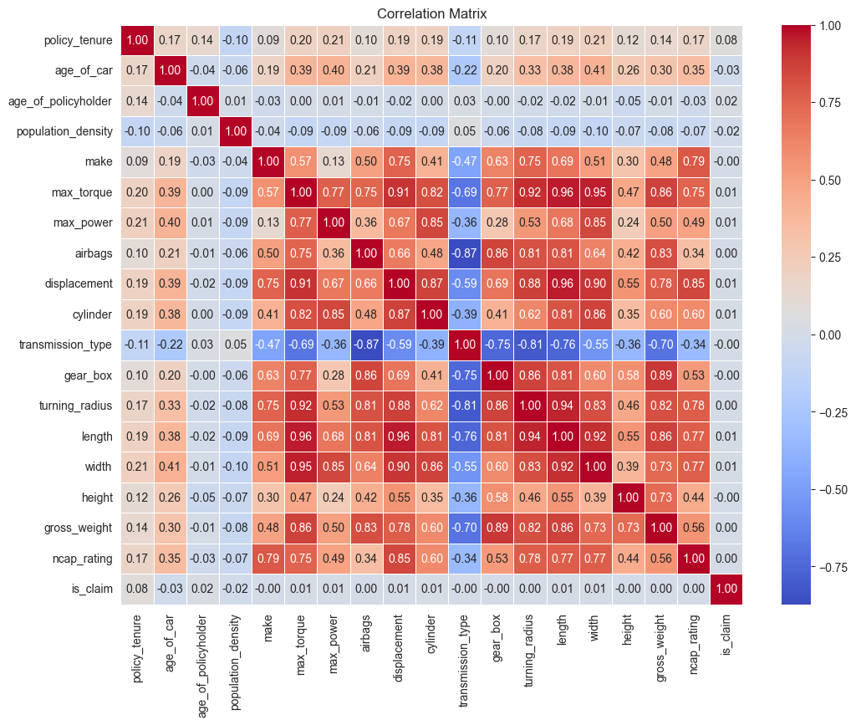
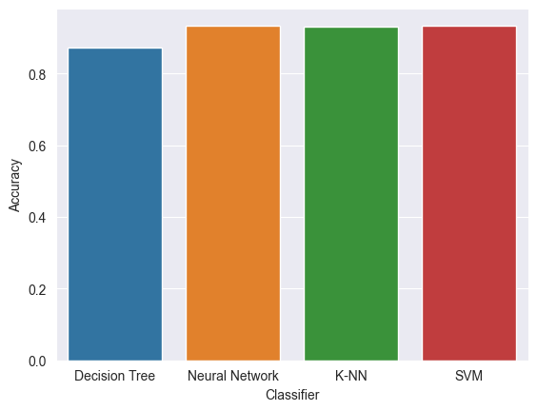
Implementation work already carried out
Data preprocess
Correlation analysis
Feature selection (based con correlation results)
Initial algorithm comparison

